Slide 1
Heart Disease Prediction Using Machine Learning
19CCE213 Machine Learning and Artificial Learning
Bachelor of Technology, Computer and Communication Engineering
2020 – 2024 Batch

Slide 2
B. Tech. CCE Team 5
S. No. | Name | Roll No.
1 | Byrapu Reddy Sadhana | CB.EN.U4CCE20010
2 | Juturu Naga Sai Loknath | CB.EN.U4CCE20025
3 | Santosh | CB.EN.U4CCE20053
4 | V Srihari Moorthy | CB.EN.U4CCE20060

Slide 3
Introduction
The work proposed in this paper focuses mainly on various data mining practices that are employed in heart disease prediction.
Records of a large set of medical data created by medical experts are available for analyzing and extracting valuable knowledge from it.
Mostly the medical database consists of discrete information, thereby decision-making becomes a complex task.
The main goal of this paper is to provide a tool for doctors to detect heart disease at an early stage.

Slide 4
Objective
The main objective for doing this research is to present a heart disease prediction model for the prediction of the occurrence of heart disease.
Further, this research work is aimed toward identifying the best classification algorithm for identifying the possibility of heart disease in a patient.
It is justified by performing a comparative study and analysis using four classification algorithms namely Support Vector Machine (SVM), K-Nearest Neighbour (KNN), Naïve Bayes and Decision Tree are used at different levels of evaluation.
Although these are commonly used machine learning algorithms, heart disease prediction is a vital task involving the highest possible accuracy.

Slide 5
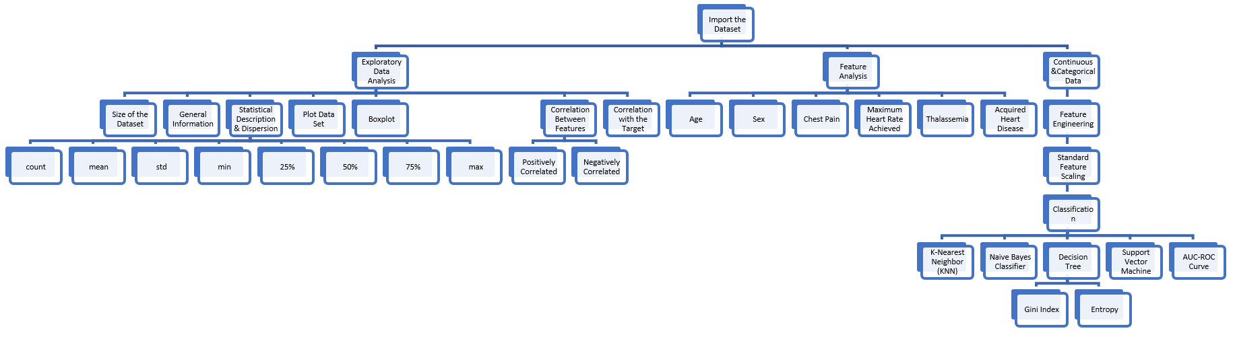
Methodology

Slide 6
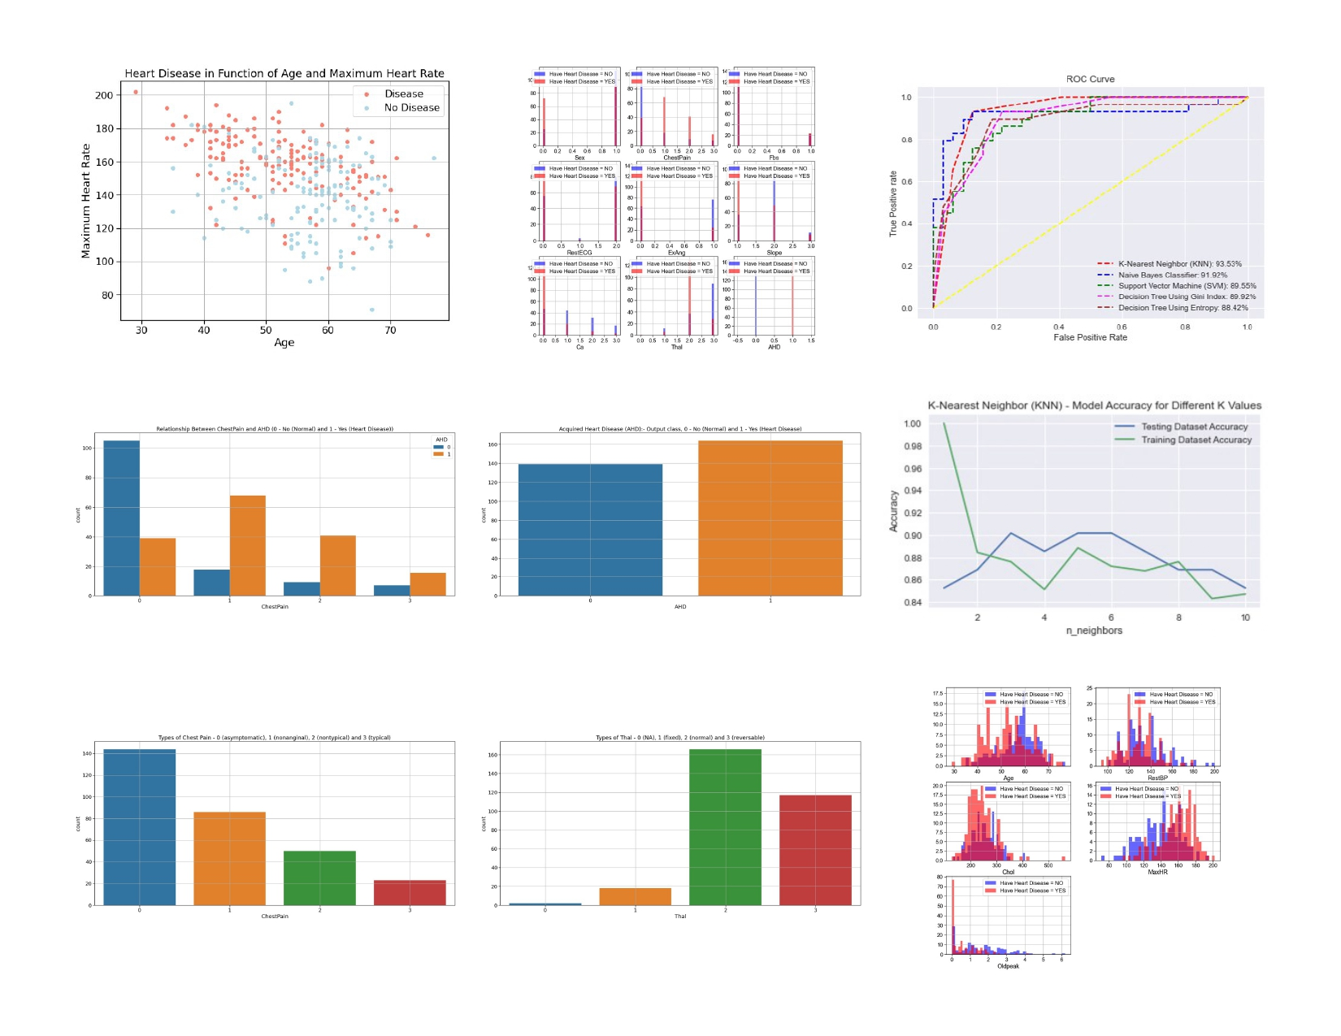
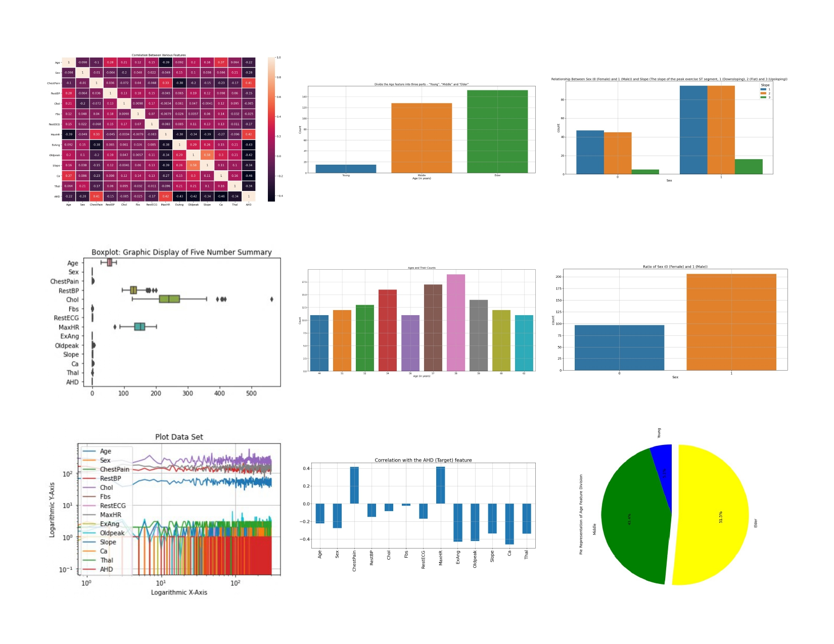
Summarized Results

Slide 7
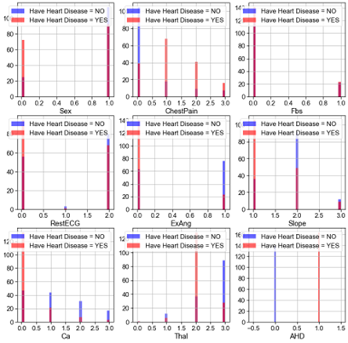
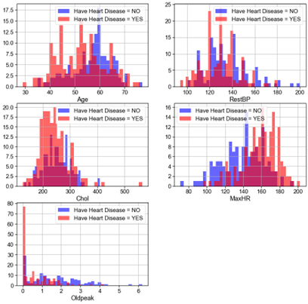
Complete Description of Continuous and Categorical Data

Slide 8
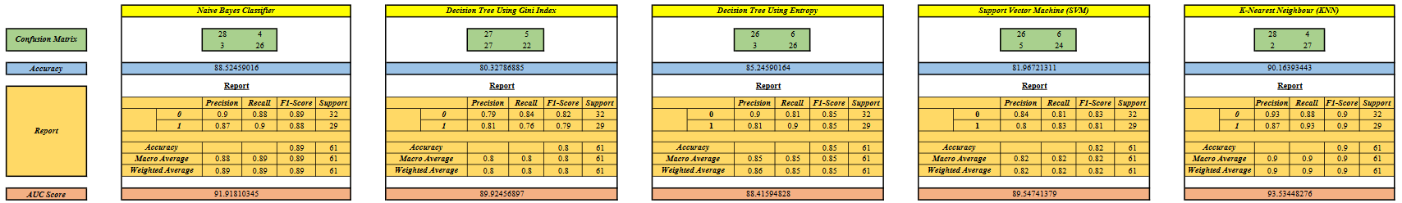
Classification

Slide 9
Conclusion
With the increasing number of deaths due to heart diseases, it has almost become increasingly mandatory to develop a proficient system to predict heart diseases effectively and accurately.
This study compares the accuracy score of K-Nearest Neighbour (KNN), Naïve Bayes Classifier, Support Vector Machine, and Decision Tree algorithms for predicting heart disease using the UCI machine learning repository dataset.
The result of this study indicates that the K-Nearest Neighbour (KNN) algorithm is the most efficient algorithm with an accuracy score of 90.16% for the prediction of heart disease.
In the future, the work can be enhanced by developing a web application based on the K-Nearest Neighbour (KNN) as well as using a larger dataset as compared to the one used in this analysis, which will help to provide better results and help health professionals in predicting the heart disease effectively and efficiently.

Slide 10
References
D. Bertsimas, L. Mingardi and B. Stellato, "Machine Learning for Real-Time Heart Disease Prediction," in IEEE Journal of Biomedical and Health Informatics, vol. 25, no. 9, pp. 3627-3637, Sept. 2021, doi: 10.1109/JBHI.2021.3066347.
N. L. Fitriyani, M. Syafrudin, G. Alfian and J. Rhee, "HDPM: An Effective Heart Disease Prediction Model for a Clinical Decision Support System," in IEEE Access, vol. 8, pp. 133034-133050, 2020, doi: 10.1109/ACCESS.2020.3010511.
Katarya, R., Meena, S.K. Machine Learning Techniques for Heart Disease Prediction: A Comparative Study and Analysis. Health Technol. 11, 87–97 (2021). https://doi.org/10.1007/s12553-020-00505-7
Dwivedi, A.K. Performance evaluation of different machine learning techniques for prediction of heart disease. Neural Comput & Applic 29, 685–693 (2018). https://doi.org/10.1007/s00521-016-2604-1

